Slide 1
IST643 Enterprise Services & Virtualized Systems Professor Rieks Fall 2022

Slide 2

Agenda
Introduction Lecture
Introduce yourself to class
Career aspirations
Go Over the Syllabus and Expectations
Break
Architecture - Lecture
What is IT and how is it managed? - Lecture

Slide 3
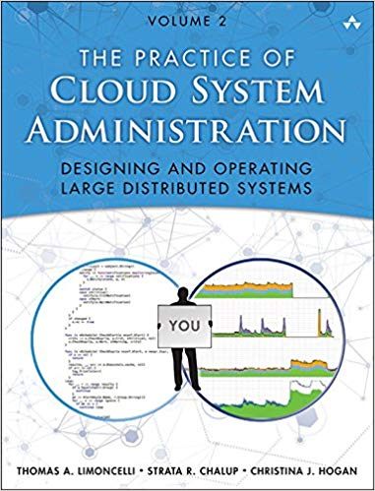
Textbook
Textbook
The Practice of Cloud System Administration, Vol 2
Limoncelli, Chalup & Hogan
A Plethora of online readings and Videos

Slide 4
Lecture Prep Assignment
You will lead a lecture and discussion based on the reading from the Textbook.
Make a PowerPoint and some reinforcing activities
About 60 minutes in length
Each Student Assigned 2 topics at random from weeks 2-6 and 10-13.
Must turn in your materials to Blackboard the day before you present
Grading based on quality of materials, accuracy of content, and how engaging your content is.
Draw names now!
Order determines which chapter / week you’ll do, as per the syllabus

Slide 5

Laboratory Assignments and Exams
Practice Activities involving technical concepts
Work on them outside of class.
Handed in in Blackboard before class.
Discussed in class.
There will be a midterm and final exam
The midterm and final exam will be a paper that you will need to write in class.
No TF / MC /
All writing

Slide 6

Questions

